Slide 1

IP FOR START-UP VENTURES
AU Center for Innovation
x
WCL IP Law Clinic

Slide 2

TRADE SECRET
Areas of Protection
Benefits
R&D information
Algorithms
Product designs
Manufacturing processes
Technical Data
Protection Is indefinite
Rights are automatic
Risks
Think about…
Everything is confidential
Once the secret is learned, it is gone forever
How much is publicly known?
Who knows about the secret?
Can the secret be easily discovered?

Slide 3
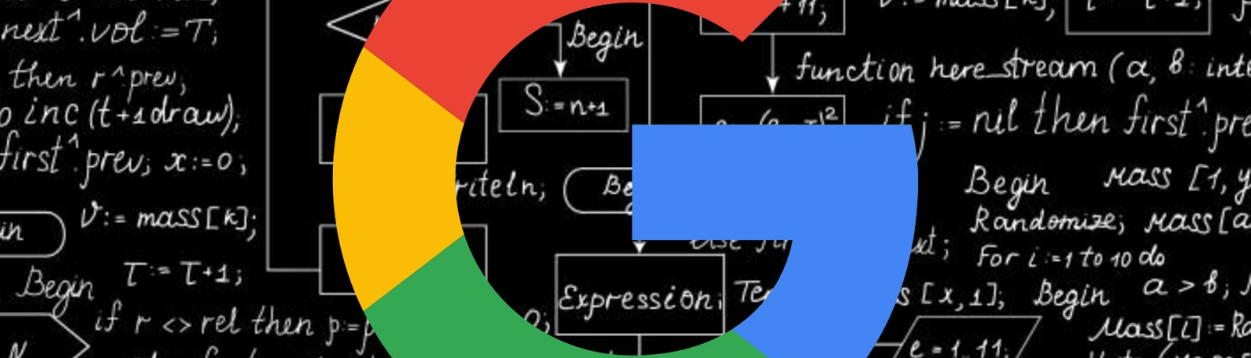
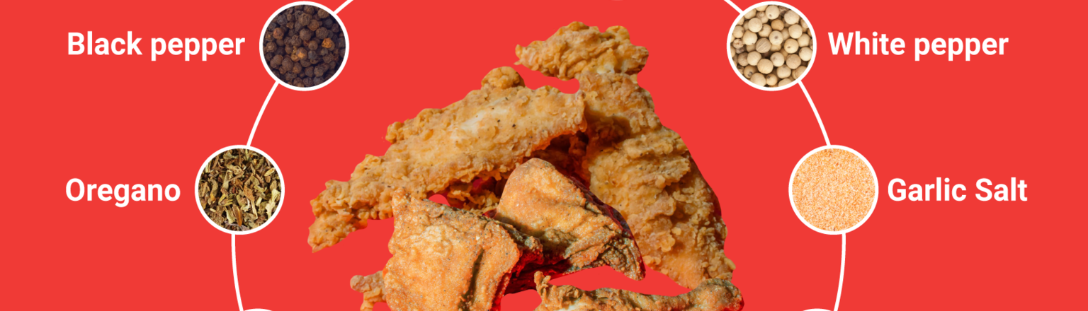
TRADE SECRET EXAMPLES
Google’s Algorithm & Ranking System
KFC’s Secret Seasoning Recipe
What aspects of your Venture do you intentionally keep secret and why?

Slide 4
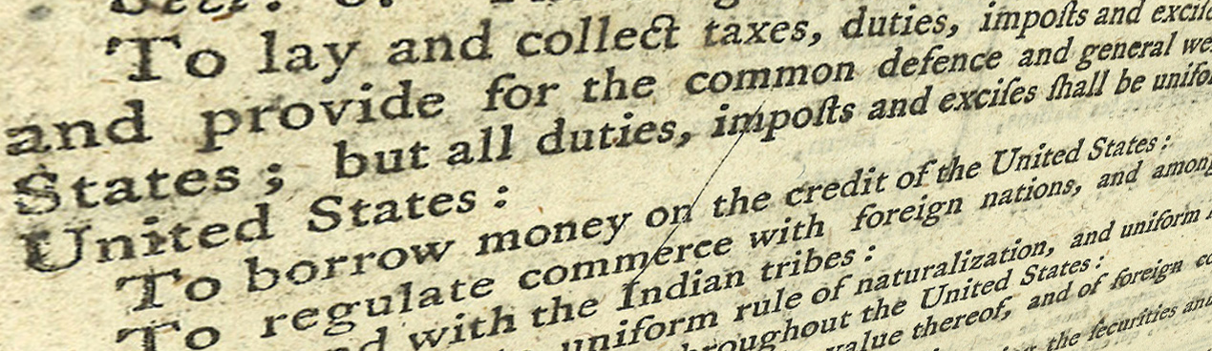
PATENT
“To promote the progress of science and useful arts, by securing for limited times to authors and inventors the exclusive right to their respective writings and discoveries.”
-Article 1 Section 8
The right to exclude others from making, selling, importing, or using the invention.

Slide 5
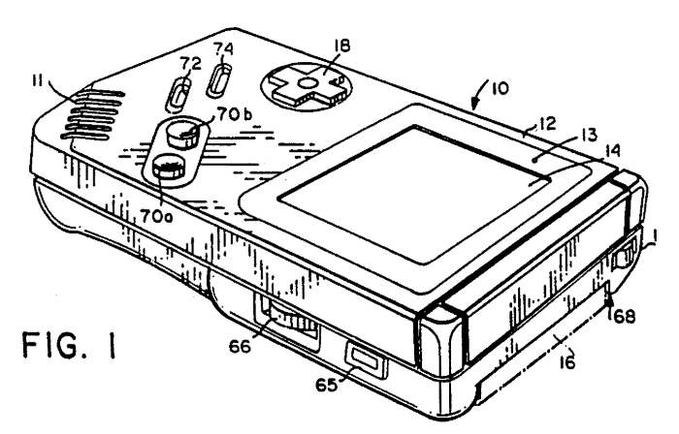
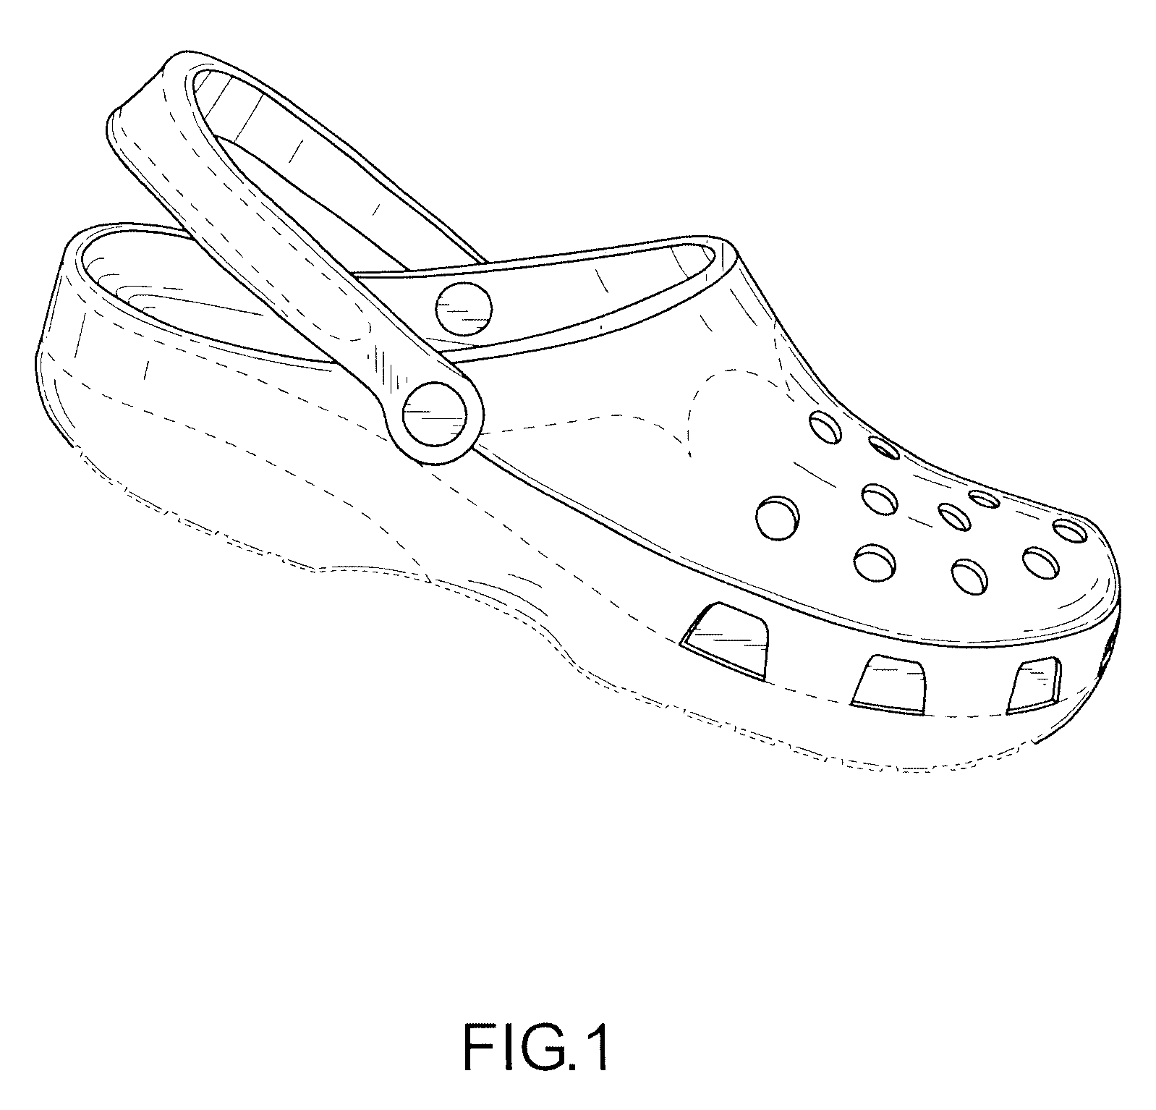
PATENT EXAMPLES
Utility Patent - Gameboy
Design Patent - Crocs
Does your Venture focus on a New and Useful innovation?
Is your innovation Functional?
Does your Venture feature an Ornamental design?
Is your feature Non-Functional?

Slide 6

TRADEMARK
Don’t mislead consumers as to the source of the product or its region of origination.
No Deception
Is imagination required to link the mark to the product or service?
Generic or merely descriptive words aren’t enough.
Be Distinctive
Must have evidence of inter-state use.
Must have actual delivered a good or performed a service for a customer.
Commercial Use

Slide 7



TRADEMARK EXAMPLES
Descriptive
Suggestive
Arbitrary / Fanciful
What category does your Venture’s name and/or Logo fall into?

Slide 8
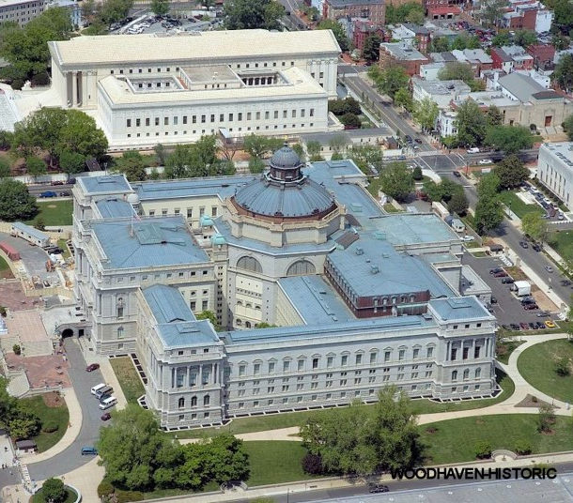
COPYRIGHT
CREATIVE WORKS
An original work of authorship,
fixed in a tangible expression,
for longer than a transitory period.

Slide 9




COPYRIGHT
EXAMPLES
Literary Works
Musical Works / Sound Recordings
Pictorial, Graphic, Sculptural Works
Architectural Works
Motion Pictures
Source Code
Data and Information
Common Societal Knowledge
Works that are NOT Fixed in Tangible Form
Ideas
Methods of Doing Things

Slide 10
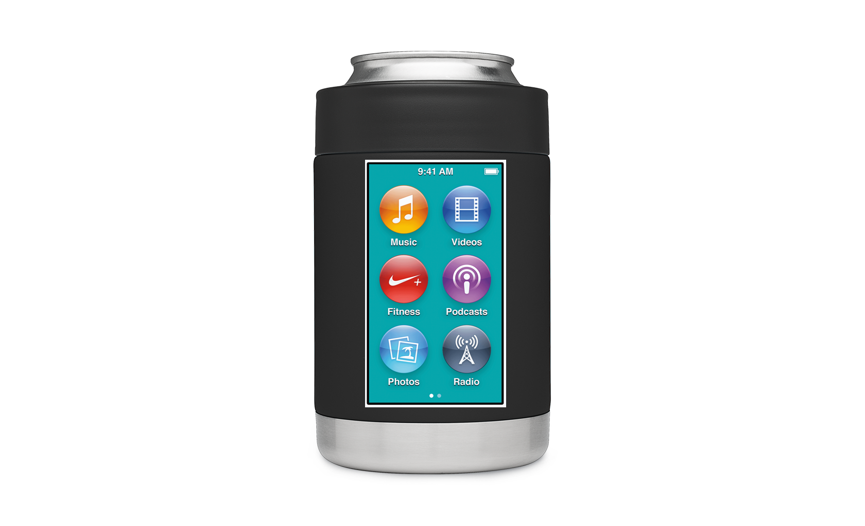
Beer Koozie,
Smart Device, and
B.A.C. Monitor
1
Define the Product or Service
How do you describe your Venture?
What makes you unique?
What is indispensable?
What is your advantage?

Slide 11

B.A.C. Software?
Finger Print Encryption?
2
4
Trade Secret
Trade Secret
Utility Patent
3
The materials that make up the device?
How the device is made?
Smart Device?
Koozie?
The Combination of the Smart Device and Koozie?

Slide 12
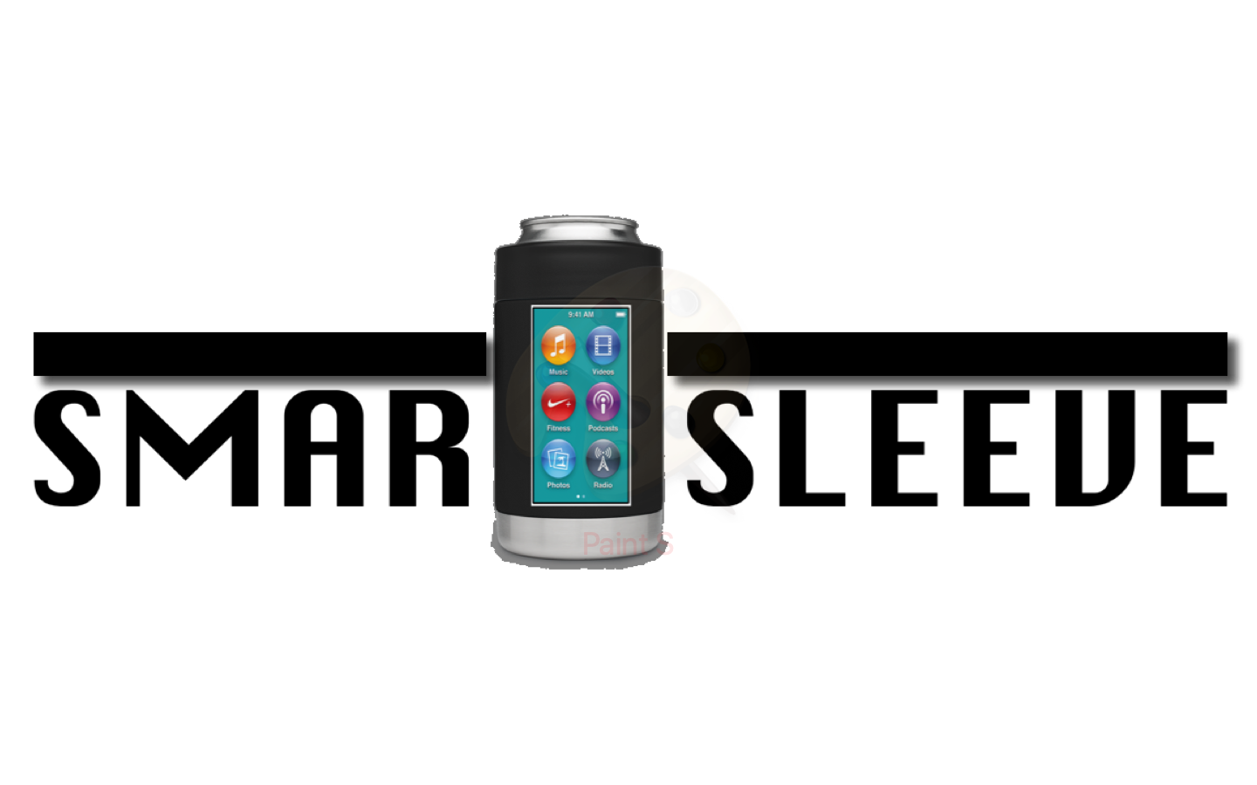
Layout of the icons
Proportions of the overall device
6
Design Patent
Trademark
5
Beer Holder
BeerSensor
SmartSleeve
Dryp

Slide 13
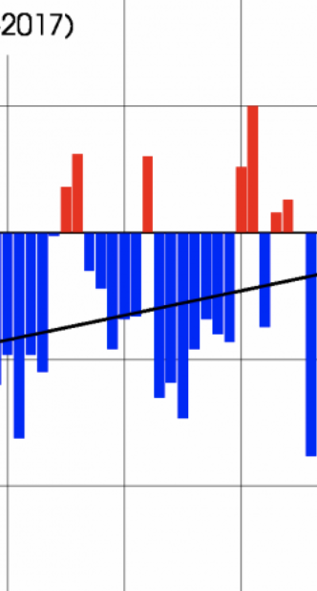


Computer Code
Marketing Photos
7
Copyright
Copyright
8
Performance Data
New Product Ideas

Slide 14

9
Evaluation
  How much will this type of IP cost?
  How long will it take to acquire this IP?
  How important is this IP to prevent competition?
  How demanding are investors for IP rights?
  Is this the right time to pursue these IP rights?

Slide 15
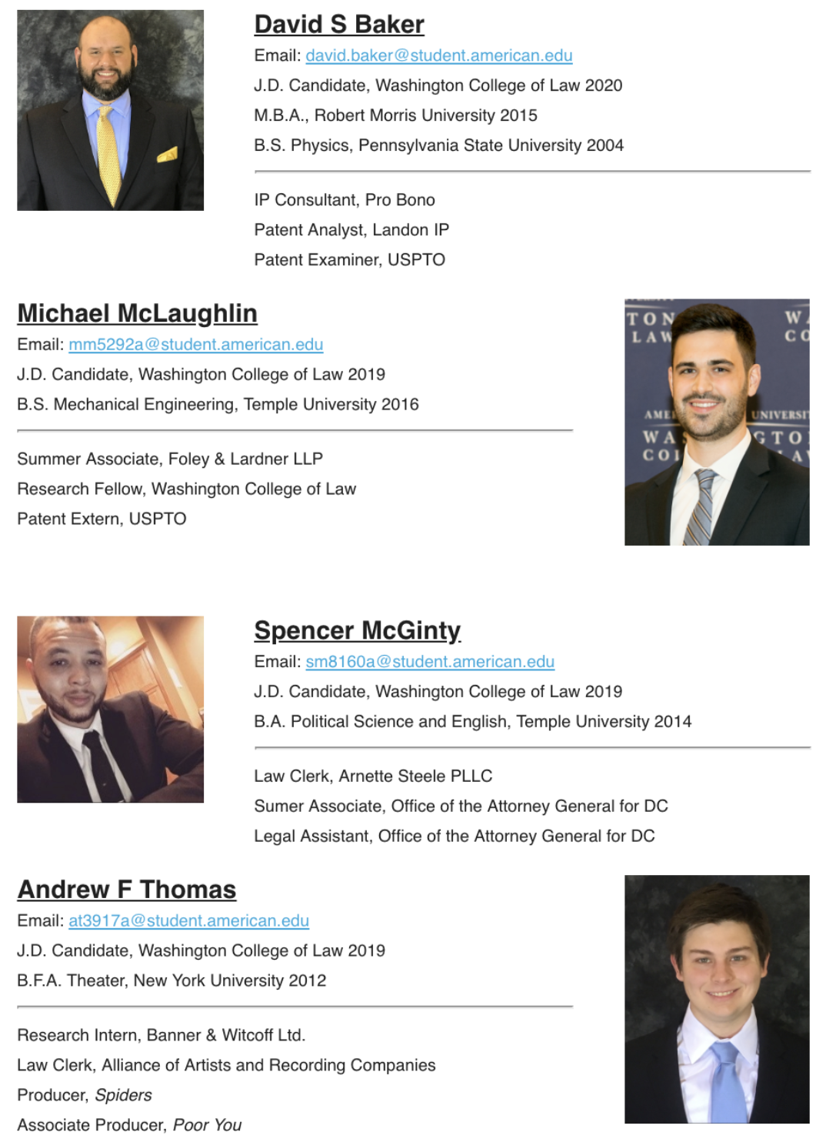
ASK
QUESTIONS

